Slide 1




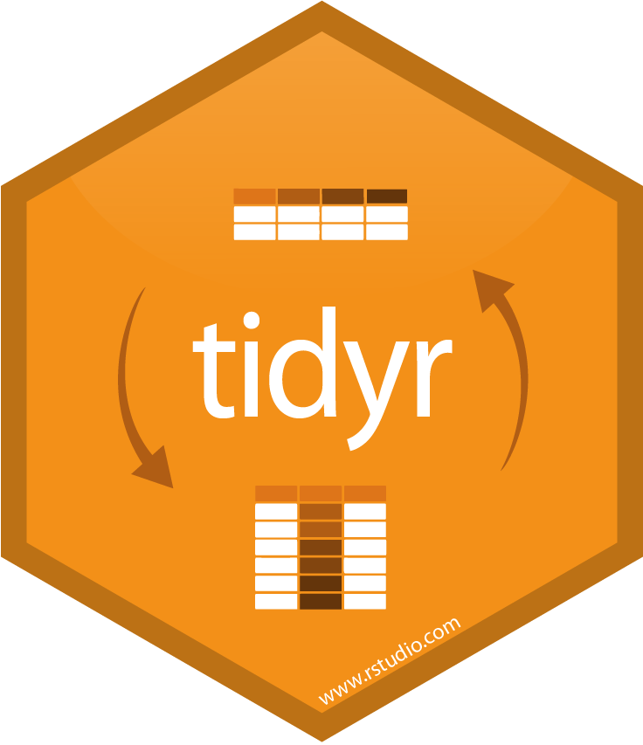

Data Wrangling in R
library(tidyverse)
Ben Best <ben@ecoquants.com>

Slide 2

For Big-Data Scientists, ‘Janitor Work’ Is Key Hurdle to Insights
nytimes.com/2014/08/18/technology/for-big-data-scientists-hurdle-to-insights-is-janitor-work.html
“Data scientists, according to interviews and expert estimates, spend from 50 to 80 percent of their time mired in the mundane labor of collecting and preparing data, before it can be explored for useful information.” –– NY Times (2014)

Slide 3
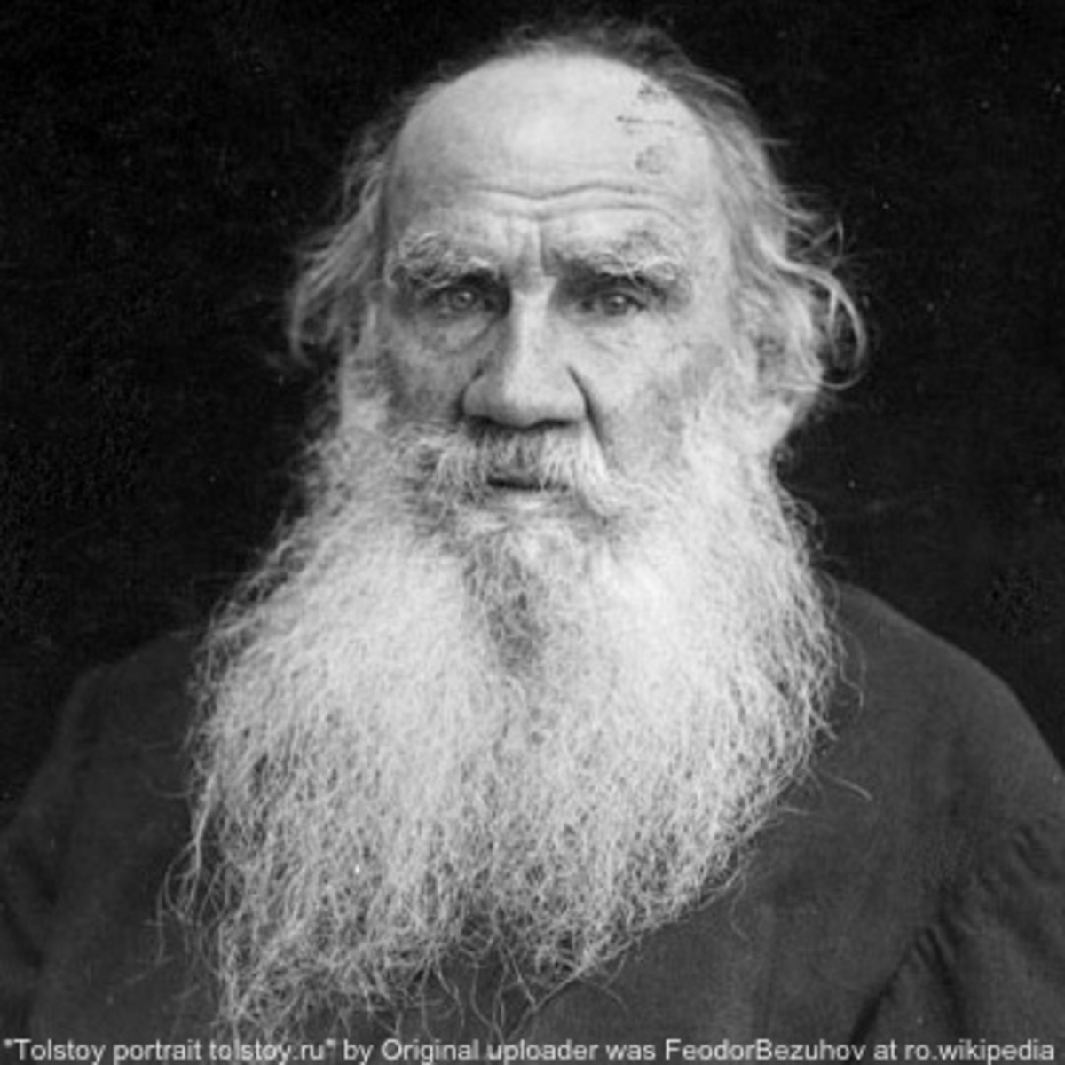

“Happy families are all alike; every unhappy family is unhappy in its own way.” –– Leo Tolstoy
“Tidy datasets are all alike, but every messy dataset is messy in its own way.” –– Hadley Wickham

Slide 4
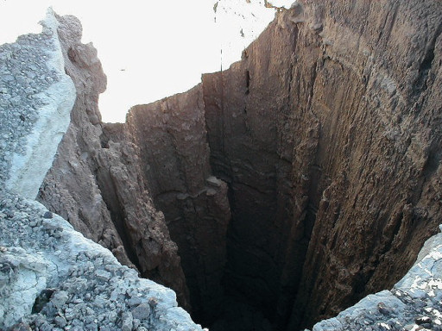


Tidy Manifesto
cran.r-project.org/web/packages/tidyverse/vignettes/manifesto.html
Reuse existing data structures
Compose simple functions with the pipe
Embrace functional programming
Design for humans
Fall into the Pit of Success
”
blog.codinghorror.com/falling-into-the-pit-of-success

Slide 5

Tidyverse process
& packages (unofficial in italics)
Program
Import
Visualize
readr, readxl
DBI jsonlite, httr googledrive
purrr
glue
rlang fs
devtools, usethis
ggplot2
ggraph ggmap
htmlwidgets: plotly leaflet
dygraphs
Tidy
Transform
Model
tibble
dplyr
tidyr
dplyr
forcats lubridate hms stringr
broom
modelr
Spatial rgdal sp -> sf
raster
Communicate
knitr, rmarkdown
DT shiny

Slide 6

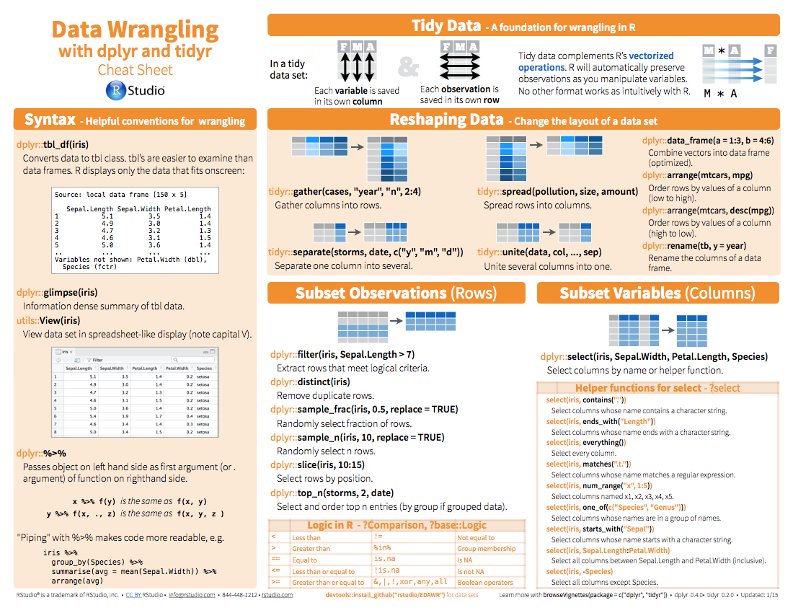
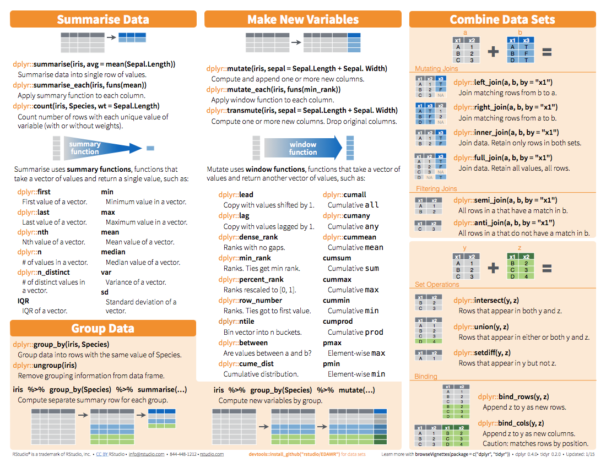
Cheatsheets are
RStudio: Help > Cheatsheets > Data wrangling with dplyr

Slide 7

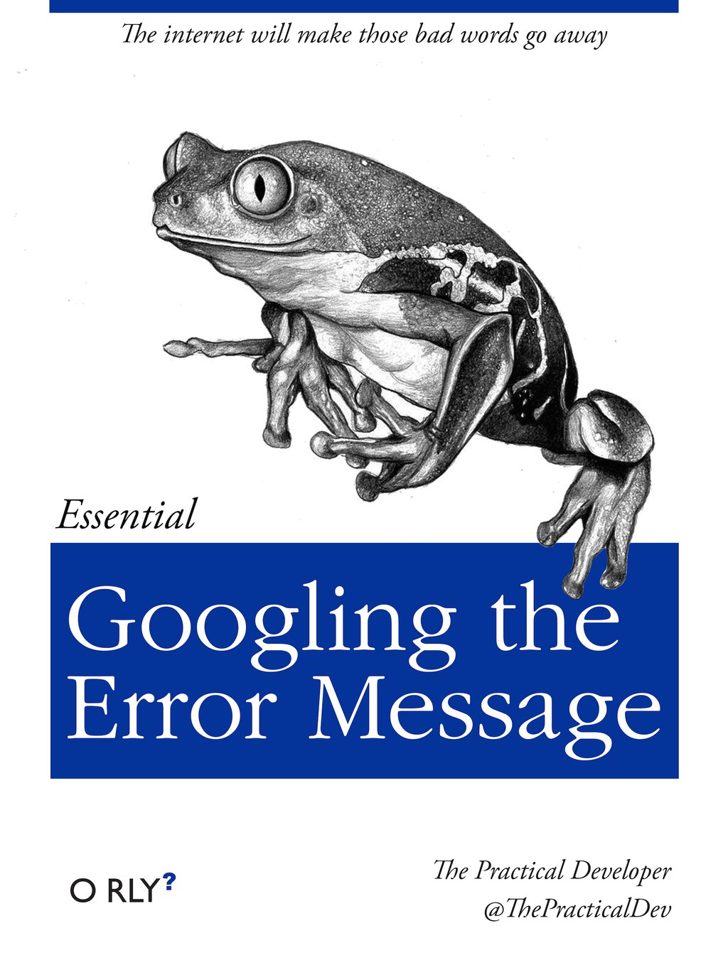
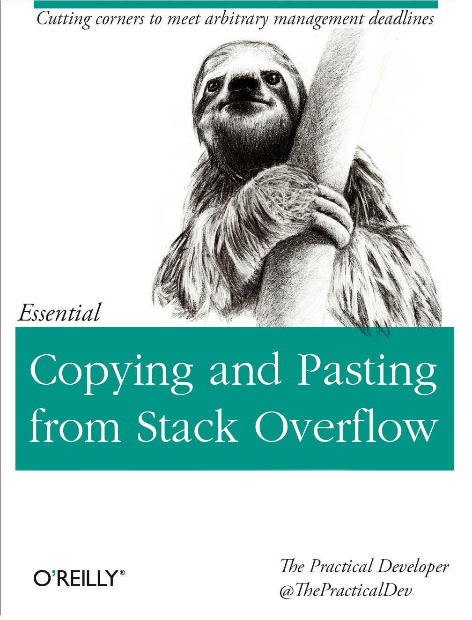
Resources
r4ds.had.co.nz
google.com
stackoverflow.com

Slide 8

Live Demo
bbest.github.io/ioos-bio-tidyr
others:
sbc-datasets: readr::read_csv(), summary(), View() dplyr:: select(), filter(), mutate(), arrange(), glue::glue(), lubridate::*, stringr::*
OHI data-science-training: dplyr:: group_by(), summarize(), join()
R-ecology-lesson: tidyr:: gather(), spread(), nest()

